Slide 1

AIRBNB HOTEL BOOKING ANALYSIS
Akansha
INTERNSHIP_17546440516895be537820f

Slide 2

PROBLEM STATEMENT
Airbnb is a popular platform where property owners rent out their homes or apartments to travelers. One of the biggest challenges for hosts is deciding the right price for their listings, since prices vary depending on several factors such as the number of bedrooms, number of bathrooms, cleanliness, accuracy of descriptions, and communication quality with guests.

Slide 3
Project Description
This project focuses on building a machine learning model to predict the price of Airbnb listings. Pricing an Airbnb property correctly is crucial for both hosts and travelers: hosts want to maximize occupancy and earnings, while travelers want fair and competitive prices. Using historical Airbnb data, the project develops a regression model that learns relationships between listing attributes (such as number of bedrooms, bathrooms, and guest ratings) and the price charged.
The model can then be used to predict prices for new or hypothetical listings, helping property owners make informed pricing decisions

Slide 4

WHO ARE THE END USERS?
Airbnb Hosts: To optimize pricing of their listings based on property features and guest reviews.
Travelers: To evaluate whether a listing is overpriced or reasonably priced.
Airbnb Platform Analysts: To improve automated pricing suggestions and increase platform trust.
Researchers/Students: To study the impact of property features and reviews on rental pricing.

Slide 5

Technology Used
Python – Core programming language
Pandas & NumPy – Data cleaning and preprocessing
Scikit-learn – Machine learning (model training, regression, evaluation)
Matplotlib/Seaborn – Data visualization and feature importance
Google Colab – Cloud-based environment for running the project
File handling libraries – openpyxl (for Excel) and built-in CSV handling

Slide 6
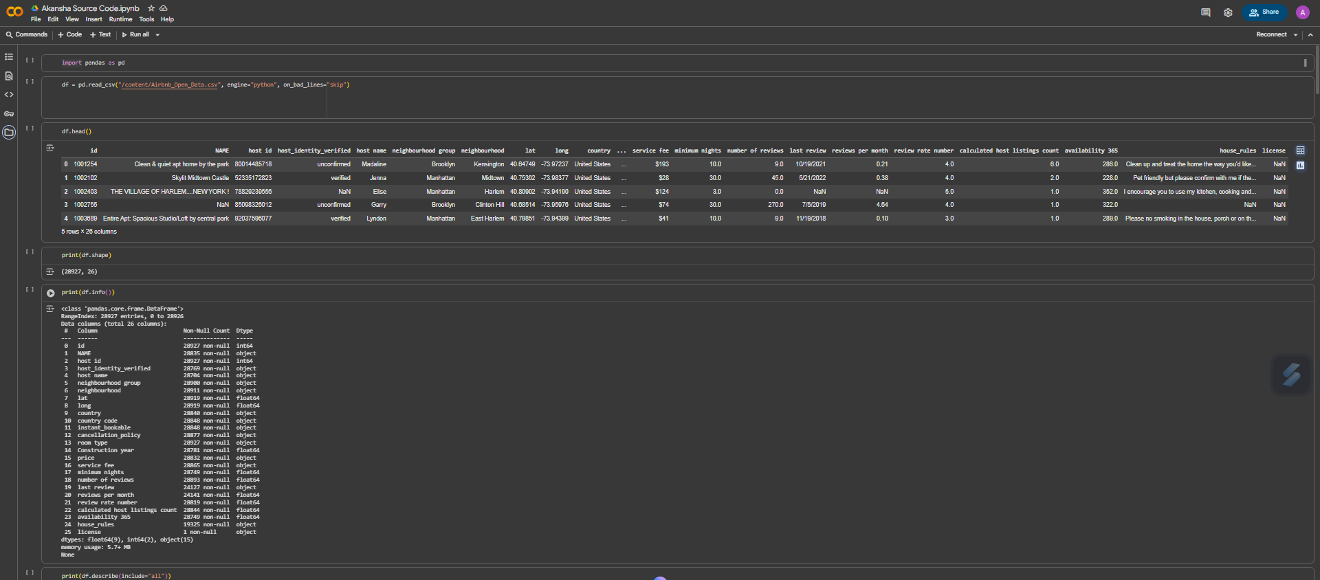
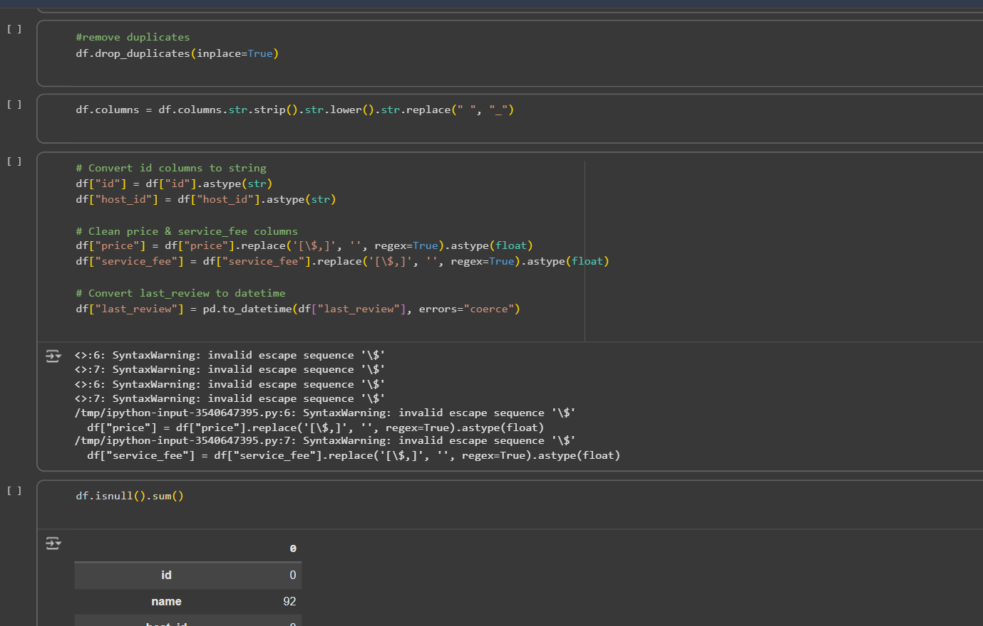
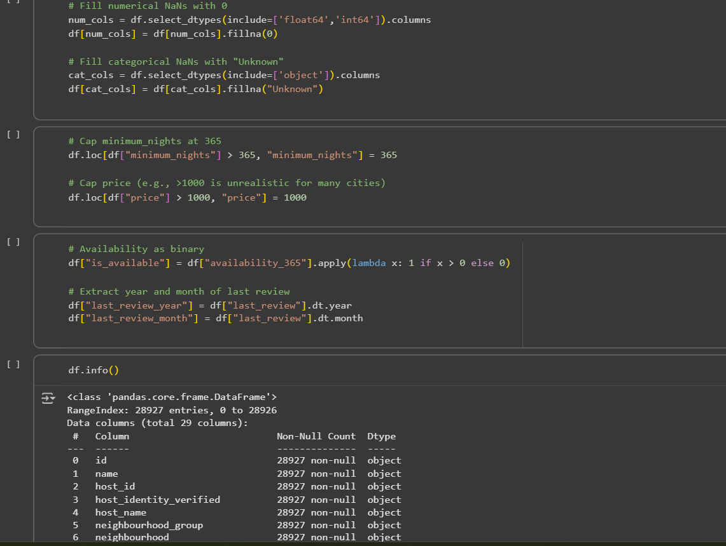
Python Code

Slide 7
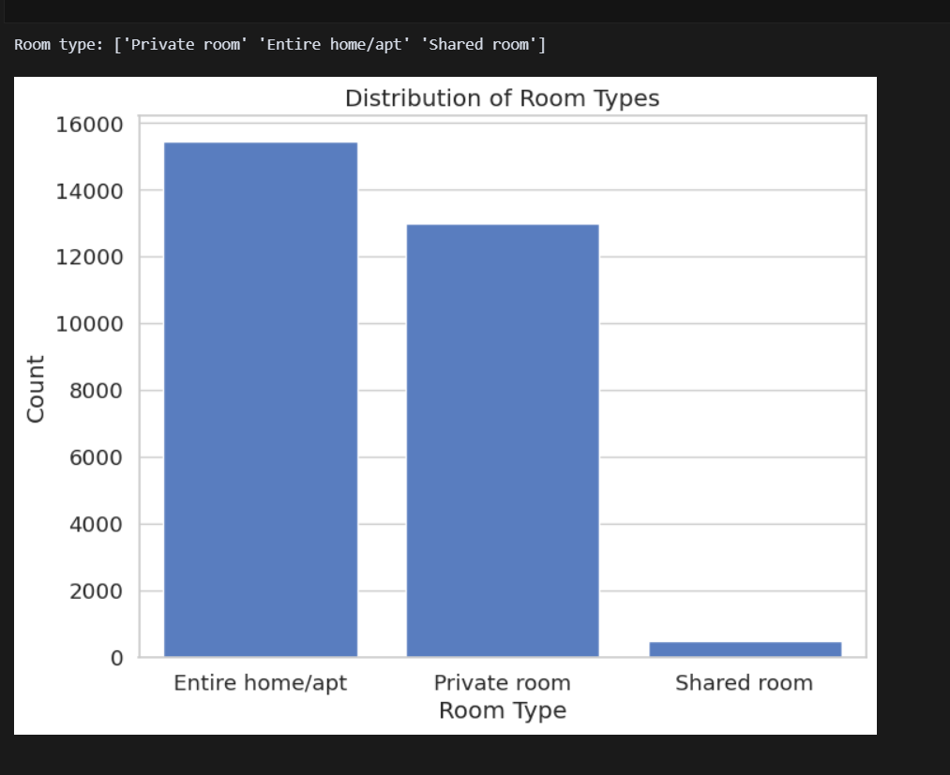
RESULTS1
Demo Link

Slide 8
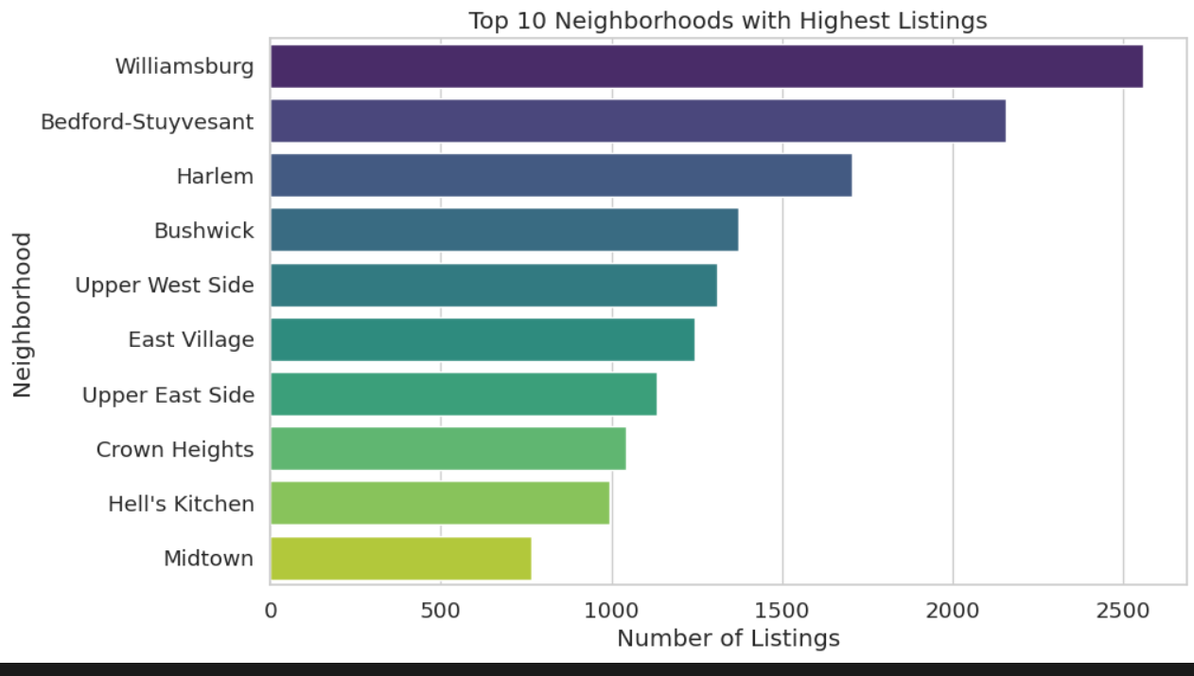
RESULTS2
Demo Link

Slide 9
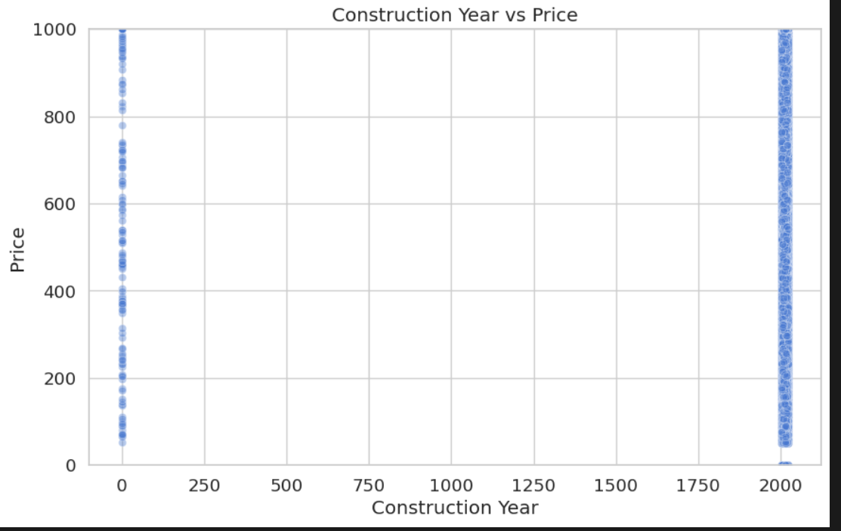
RESULTS3
Demo Link

Slide 10
GitHub repository
https://github.com/Akansha-Rana20/VOIS_AICTE_Oct2025_Akansha
Demo Link

Slide 11
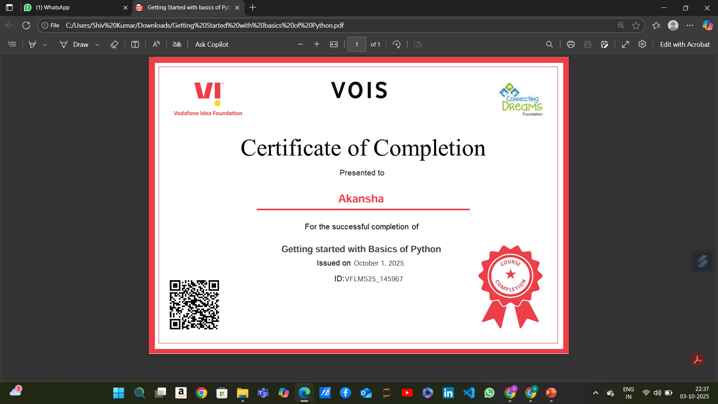
Getting started with Basics of Python Certificate

Slide 12

Data Visualization Certificate

Slide 13
Thank you
.
.

